Slide 1
“Design and Performance analysis of Solar Lawn Mower”
GROUP-D,4th YEAR
MECHANICAL ENGINEERING DEPT.
Techno International New Town

Slide 2
CONTENTS
INTRODUCTION
OBJECTIVE
WORKING OF SOLAR GRASS CUTTER
DESIGN STRUCTURE AND SIMULATION
HARDWARES AND COMPONENTS
STRUCTURAL COMOPONENT
BLOCK DIAGRAM
OTHERS IMPORTANT EQUIPMENT
COSTING AFTER COMPLETE PROJECT WORK
RESULT AND DISCUSSION
CONCLUSIONS AND FUTURE SCOPE
REFERENCES

Slide 3
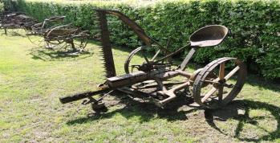
INTRODUCTION:
The first lawn mower was invented by Edwin budding in 1830 in trump, just outside Stroud, in Gloucestershire, England.
Solar grass cutter are environmental friendly.
Communicative Cutter is an autonomous robot used to cut lawn grass.
This prototype will charge from sun using solar panels.
The main purposes of the project is to make it less costlier than before and also make it less weighty to run over the ground.

Slide 4
OBJECTIVES:
The purpose is to avoid energy crisis in India and reduces the human efforts, operating cost and maintenance cost.
To know the working principle of Communicative grass cutter.

Slide 5
COMPONENTS OF THE MODEL

Slide 6
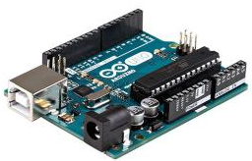
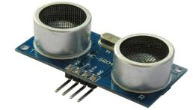
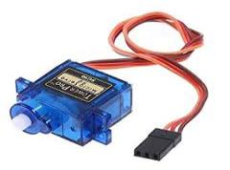
HARDWARE AND COMPONENTS
Arduino Uno R3 :-
Arduino is an open-source platform used for building electronics projects. ... Additionally, the Arduino IDE uses a simplified version of C++, making it easier to learn to program
Ultrasonic Sensor:-
An Ultrasonic sensor is a device that can measure the distance to an object by using sound waves. it is possible to calculate the distance between the sonar sensor and the object.
Servo Motor:-
Servomotor is a rotary actuator or linear actuator that allows for precise control of angular or linear position, velocity and acceleration

Slide 7
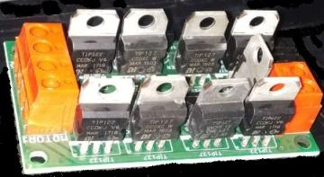
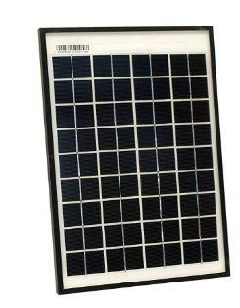
Motor Driver:-
Motor drives are circuits used to run a motor. In other words, they are commonly used for motor interfacing.
Solar panel:-
Photovoltaic solar panels absorb sunlight as a source of energy to generate electricity. A photovoltaic (PV) module is a packaged, connected assembly of typically 6x10 photovoltaic solar cells. Photovoltaic modules constitute the photovoltaic array of a photovoltaic system that generates and supplies solar electricity in commercial and residential applications.

Slide 8
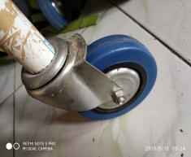
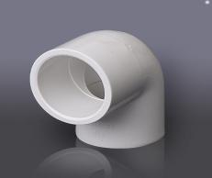
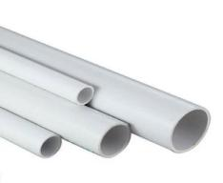
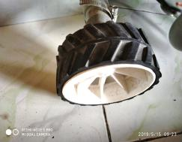
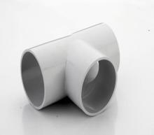
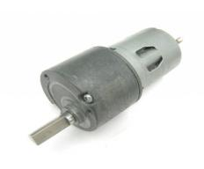
STRUCTURAL COMOPONENT :-
360 WHEEL
ELBOW JOINT
AGRICULTURE PIPE
ROBOTIC WHEEL
T-JOINT
GEAR MOTOR

Slide 9
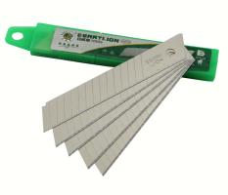
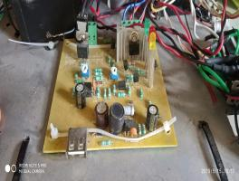
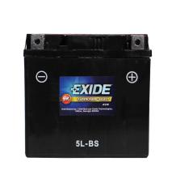
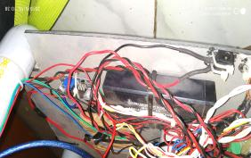
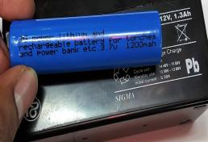
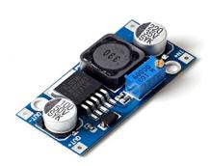
OTHERS IMPORTANT EQUIPMENT
Dry cell battery
CUTTING BLADE
SOLAR CHARGE CONTROLER
12V- 0.3 amp *5-10 hrs.
LEAD ACID BATTERY 3000 mah
lithium ion battery 1200 mah
Voltage Booster Module

Slide 10
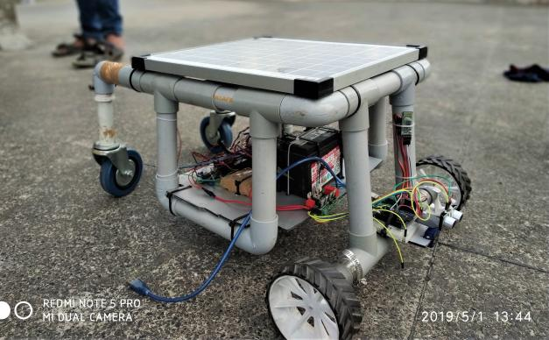
Assembled structure:

Slide 11
WORKING PRINCIPLES OF THE MODEL

Slide 12
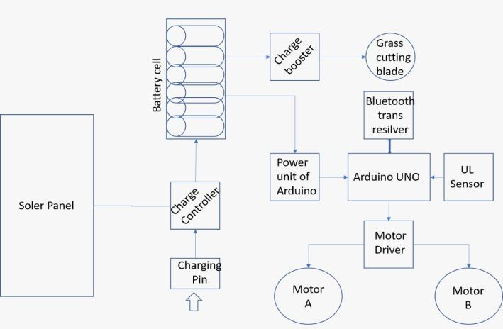
BLOCK DIAGRAM

Slide 13
WORKING OF SOLAR GRASS CUTTER
It has a panels mounted in a particular arrangement at an in such a way that it can receive solar radiation with high intensity easily from the sun.
Through this solar panel it converts solar energy into electrical energy.
This machine consists of the photovoltaic DC to DC converter, motor, controller, linear blades, battery.
It’s an automated system for the purpose of grass cutting.
The Arduino Uno board interfaces the microcontroller with the DC motor and Ultrasonic sensor along with the solar panel. The Arduino Uno board has an USB which will be used to load the programs from computer.

Slide 14
DESIGN AND DRAWING

Slide 15
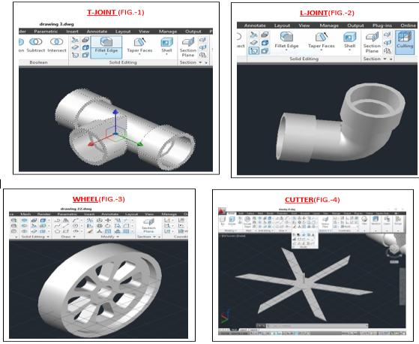
IMAGES OF VARIOUS DESIGNED PARTS FROM AUTOCAD:

Slide 16
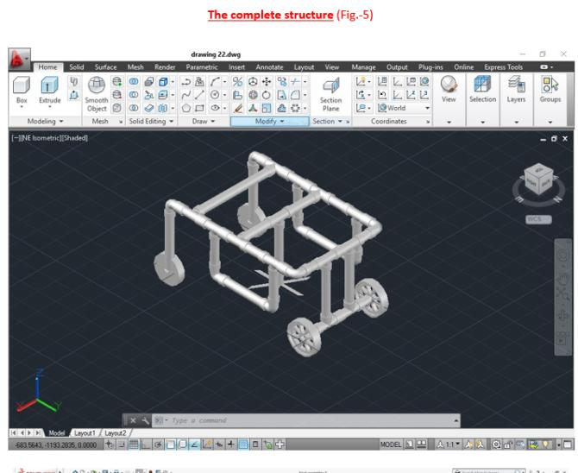

Slide 17
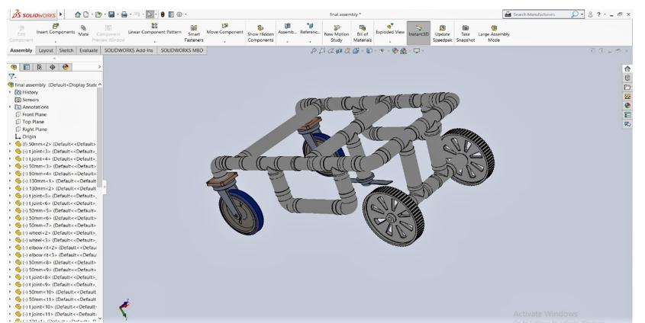
IMAGE OF DESIGNED PARTS FROM SOLID WORKS:

Slide 18
SIMULATION AND ANALYSIS OF BLADE BY SOLID WORKS

Slide 19
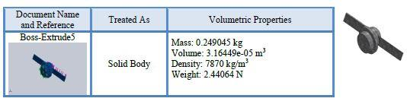
ASSUMPTIONS

Slide 20
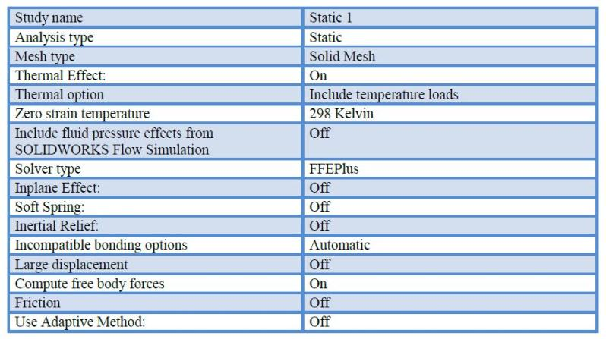
STUDY PROPERTIES

Slide 21
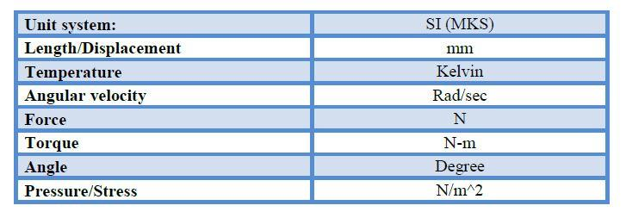
UNITS

Slide 22
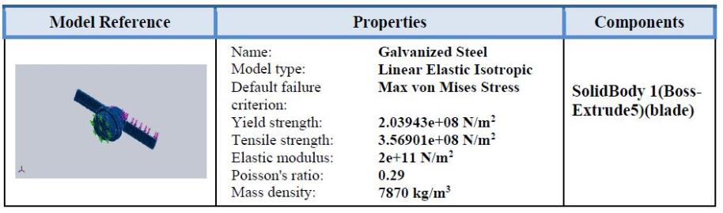
MATERIAL PROPERTIES

Slide 23
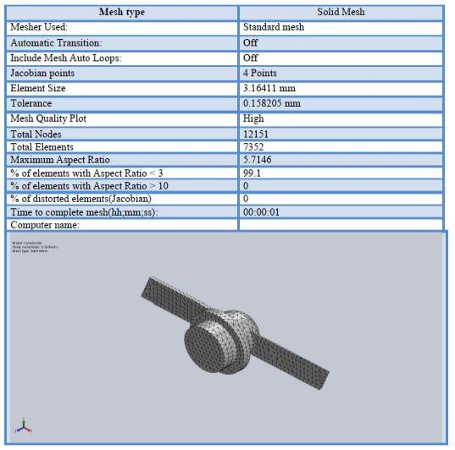
MESH INFORMATION DETAILS

Slide 24
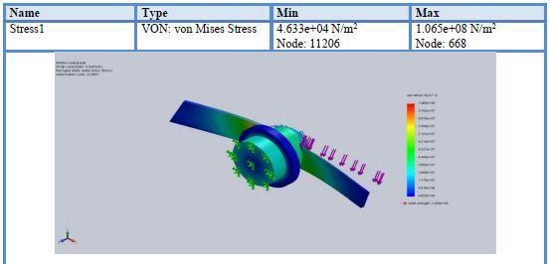
STATIC STRESS ANALYSIS OF BLADE

Slide 25
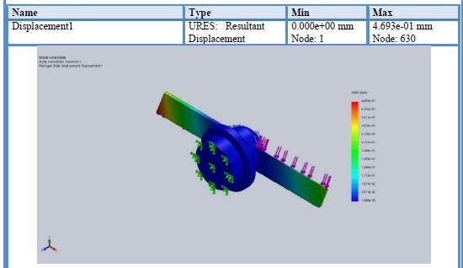
STATIC DISPLACEMENT ANALYSIS OF BLADE

Slide 26
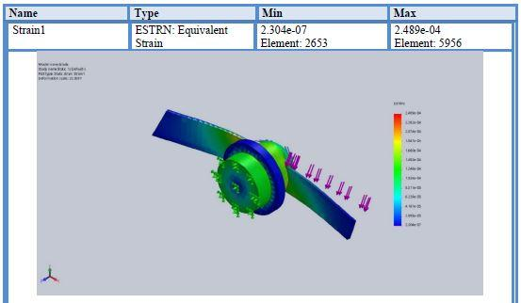
STATIC STRAIN ANALYSIS OF BLADE

Slide 27
RESULT AND DISCUSSION

Slide 28
COSTING AFTER COMPLETE PROJECT WORK
components | quantity | cost(rs.)
Jonson motor | 2 | 300*2=600.00
wheels | 4 | 100*4=400.00
cutting blade | 1o | 25.00
motor(used for cutting) | 1 | 100.00
solar panel | 1 | 630.00
pvc pipe,t & l joint | 15 ft. | 1100.00
clamp | 5 | 110.00
wire | - | 20.00
black tape | 1 | 10.00
arduino uno r3 with cable | 1 | 420.00
ultrasonic sensor | 1 | 80.00
servo motor | 1 | 130.00
motor driver | 1 | 100.00
solar charge controller | 1 | 500.00
bluetooth module | 1 | 230.00
voltage booster module | 1 | 110.00
switch + charge port | 2+1 | 5*3=15
Acid Battery | 1 | 1300.00
alolight glue | 1 | 30.oo
breadboard | 1 | 50.00
jumper wire | 10 | 3.00
led+diode | 5+5 | 3*10=30.00
heat string | 1 | 10.00
tie band | 20 | 1*20=20.00
resistor | 5 | 1*5=5.00
others | -- | 1000.00
GRAND total = 5,958.00

Slide 29
CONCLUSIONS AND FUTURE SCOPE
Conclusion:
Today the most promising source of energy where everyone focusing is the concept of solar power and its utilization. Generally, we see people who had gardens use grass cutting machine manually to cut the unwanted grass. Those grass cutting machine are powered from normal household’s power through cables or using petrol/diesel. Using cables creates messing problem and if there is any power cut, we can’t use that grass cutting machine. Similarly, if we use petrol/diesel powered machine, it requires money and they create pollution through the smoke. Through this project, you are going to build a unique automatic solar grass cutter (grass cutting machine) which is powered by solar energy and it will overcome all the above mentioned problems. By using this system, we can preserve the non-renewable sources of energy such as petrol, gasoline etc. We can also reduce various forms of pollutions such as air pollution and noise pollution. Electricity is saved as we utilize solar energy that is renewable source of energy and is present in abundance.
Future scope:
1) This project will be useful in backyard or garden, playgrounds, home, public-parks to remove the unwanted grass/weeds.
2) As the grass cutter is eco-friendly, so there is a chance to use this machine widely.
3) Size can be reduced to make it compact.
4)Efficiency can be improved by increasing the battery capacity.
5) More sensors can be incorporated for accurate results and improved automation.
6)Programming can be enhanced to make the device perform different operations.

Slide 30
REFERENCES
1. SOLAR BASED GRASS CUTTER Ms. Yogita D. Ambekar, Mr. Abhishek U.Ghate
2. Imperial Journal of Interdisciplinary Research (IJIR) A Review on Smart Solar Grass cutter with Lawn Coverage Amol T. Bagul, Shivani G. Deore, Ashish D. Dhage & Prof. S. S. Bhardwaj.
3. Google Wikipedia
4. International Research Journal of Engineering and Technology (IRJET) solar powered automated grass cutter machine sagar v. Palve, kunal panchal, rahul chipkar, ajay patil, ganesh l. Sonawane.
https://nevonprojects.com/smart-solar-grass-cutter-with-lawn-coverage/
https://www.arduino.cc/en/Tutorial/HomePage?from=Main.Tutorials
https://www.youtube.com/watch?v=QO_Jlz1qpDw

Slide 31


